Slide 1






Environmental Factors
THAT AFFECT FOOD CHOICES

Slide 2
HYOTHESIS TESTING
Environmental Food Factors can contribute to unhealthy food choices.

Slide 3
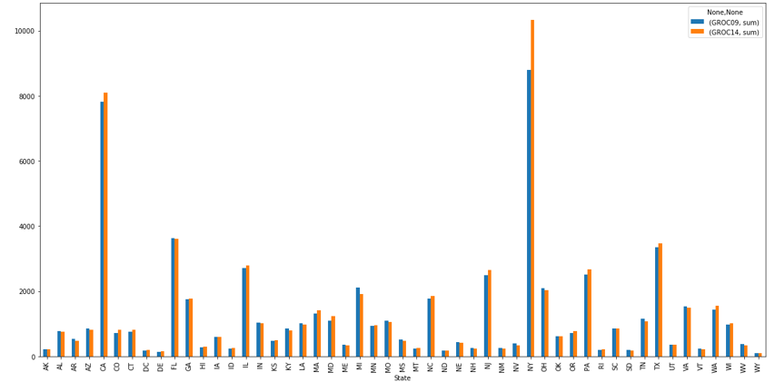
Variables: Grocery Stores in 2009 & Grocery Stores in 2014
There is seem to be an increase overall grocery stores across all counties in the state of Texas. Stores have increased from 2009 to 2014 with NY having the maximum increase.

Slide 4
Variables: Grocery Stores in 2009 & Grocery Stores in 2014

Slide 5
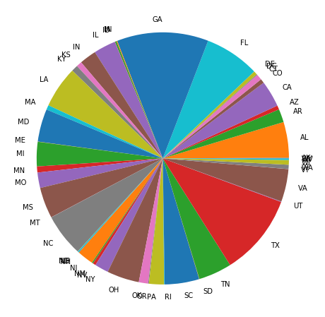
Asian Access to stores in 2015 stores in 2015
California , Texas and NJ have maximum Asian Access to stores in 2015

Slide 6
Black Access Stores in 2018
Texas, Georgia, and Florida have maximum Black Store Access in 2015

Slide 7
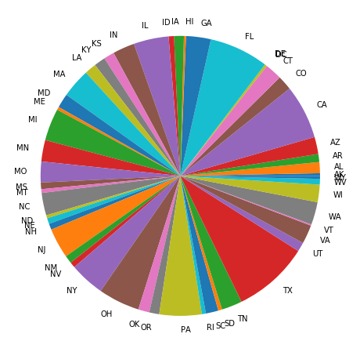
White Access Stores in 2018
Texas, California, and Florida have maximum White Store Access in 2015

Slide 8
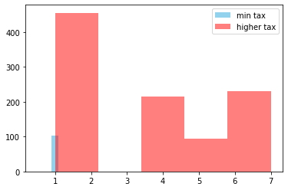
Probability Mass Function

Slide 9
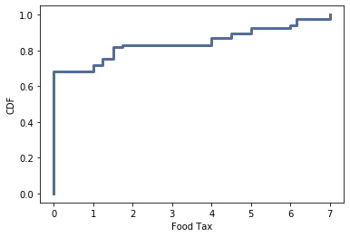
Cumulative Distribution Function

Slide 10
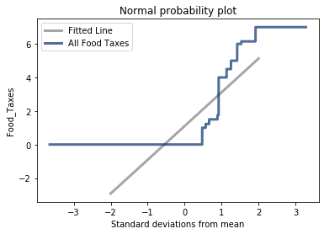
Analytical Distribution

Slide 11
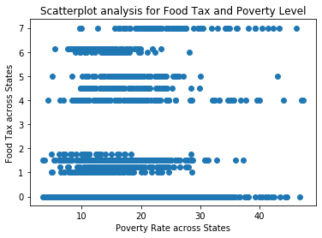
Scatterplot

Slide 12
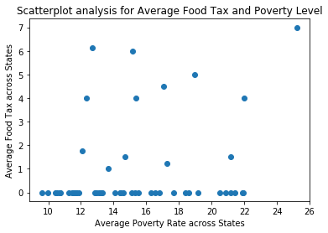
Scatter Plot

Slide 13
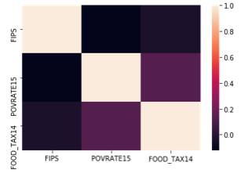
Correlation

Slide 14
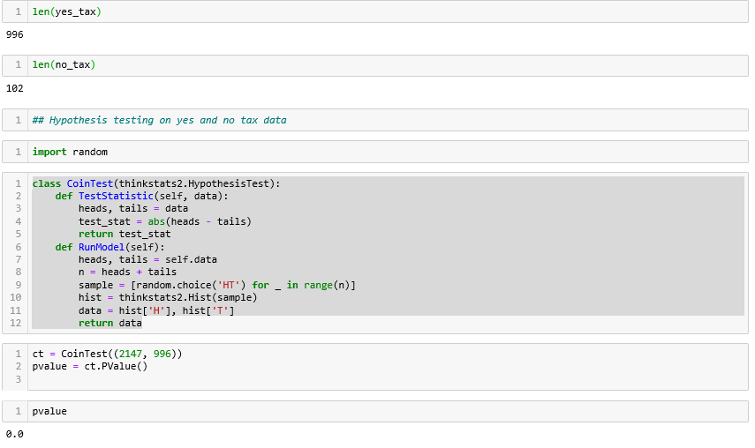
Hypothesis Testing

Slide 15
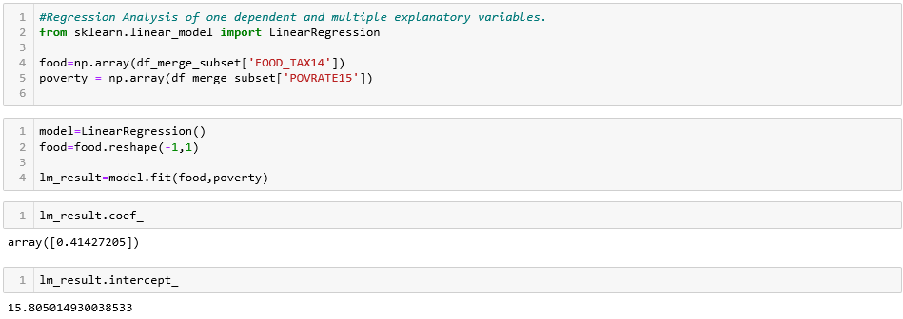
Regression
Analysis

Slide 16
Summary
Food Taxes and Poverty can almost certainly add to picking unfortunate decisions. The dataset that was used to analyze the data doesn't provide all the key components to determine if nourishment duties and neediness infer causation. A progressively definite examination with different datasets which incorporates solid and unfortunate nourishment decisions, weight, and exercise ought to be closed to finish the correct investigation.

